Slide 1
Data Interpretation, Management and Wrangling
Dr. Alexander Victor
Alexander.victor@dbs.ie

Slide 2
Data Interpretation, Management and Storage

Slide 3


Overview
Thinking about and interpreting data
Datasets
Data types
Data as vectors and matrices
Data management and storage
Storing data in files
Storing data in databases
Data wrangling and cleaning
Filtering and transforming
Imputing missing values
Fusing multiple data sources

Slide 4
Interpreting data

Slide 5
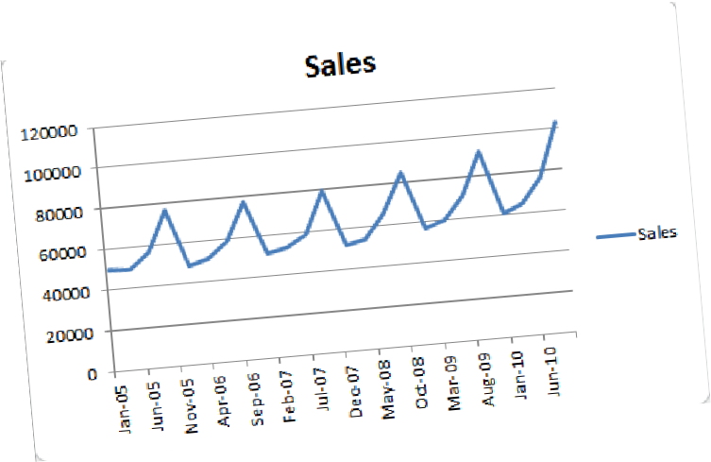
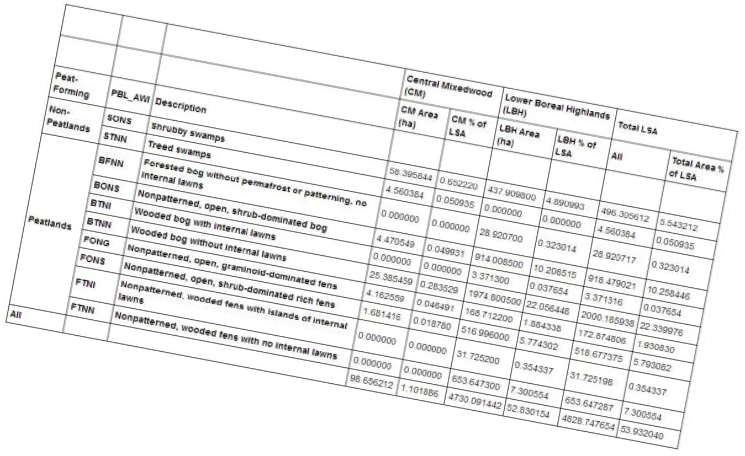
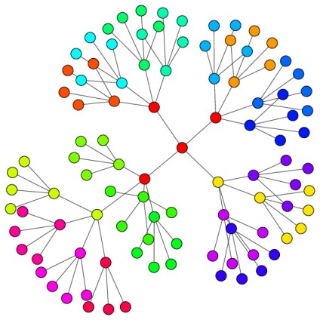
Datasets
Data can come in a variety of forms
Series (1D)
Tables
Trees
Graphs
Text
Multimedia
In general, it can always be flattened into tables.
Tables listing connected nodes in a graph

Slide 6
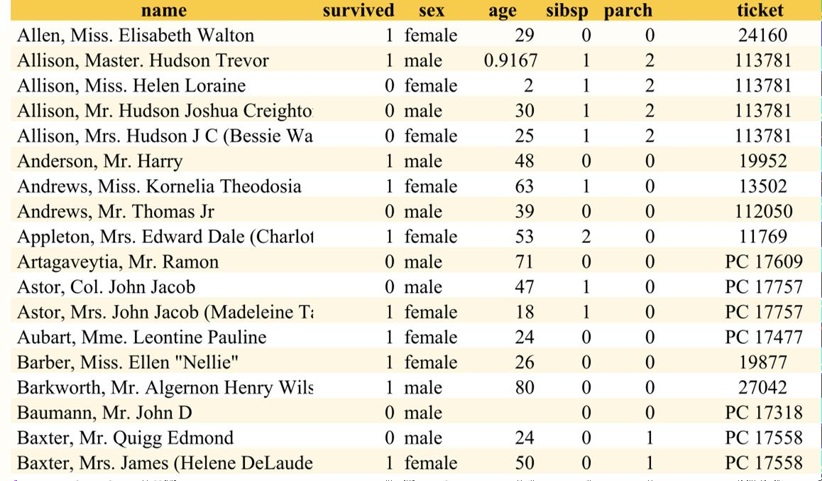
Examining datasets
Two types of information in datasets
The titanic dataset
Metadata: data about data. Usually contains semantics (meaning)
Data: the values. AKA attributes, features,
measurements, variables, variates.
In tables:
Rows contain items (AKA examples, instances, data points)
Columns contain attributes
Header contains semantics (metadata)

Slide 7
Attribute types
Many different ways we can classify the types of
attributes in a dataset
The titanic dataset
Programmer types:
Mathematical sets:
String
Integer
Float
Boolean
Real
Complex
Rational
Integer
Much more useful in data analytics to classify them according to which operations can be performed on them.

Slide 8
Scales of measurement
One of the most useful methods for classifying attribute types is
levels/scales of measurement
Defines what operations you are allowed to perform on the variables
(<, +, etc)
Stevens’ four scales of measurement [Stevens, 1946]
Nominal
Ordinal
Interval
Ratio
Stronger assumptions!
Note: values also referred to as variables, attributes, and
measurements

Slide 9
Nominal variables
Permissible statistics:
In nominal measurement the values just name
the attribute uniquely. No ordering of is implied.
Also called categorical variables
Examples:
{ male, female }
{ yes, no }
{ Ireland, UK, France, Spain, Italy, … }
{ Ford, Nissan, Mercedes, … }
Vocabulary { a, the, person, hat … }
Valid operations:
● =, ≠
Counts
Modes
Contingency correlation
It never make sense to compare nominal variables for order:
Ireland > France ?
It never makes sense to perform arithmetic nominal variables:
Yes + No = ?
AVERAGE([male, male, female])

Slide 10

Ordinal variables
Ordinal attributes (variables) can be rank-
ordered.
Examples:
Exam grade { A+, A, A-, B+, B, B-, … }
Clothing sizes { XS, S, M, L, XL }
Position in a race { 1st, 2nd, 3rd }
Permissible statistics:
Median
Percentiles
Spearman correlation
Ordered, so makes sense to compare:
Large > Medium
Does not make sense to find mean, standard
deviation, etc.
Valid operations:
● =, ≠, <, >,
(≤, ≥)

Slide 11
Quantitative variables
Quantities. Real numbers.
For both, we can do arithmetic
Interval: =, ≠, <, >, +, −
Ratio: =, ≠, <, >, +, −, ✕, ÷
Two subtypes:
Interval: distance between attributes does have meaning but there is no absolute zero.
Ratio: same as interval but with a meaningful
absolute zero.
Permissible statistics:
Mean
Standard deviation
Pearson correlation
Interval:
Date (1 Jan)
Temperature in degrees F.
Geometric point
For ratio variables, ratios make sense:
10 meters is twice 5 meters
Ratio:
Length, mass, temperature (in Kelvin)
Age, height, weight
For interval variables, only intervals make sense
6 of Feb is ? to Jan 1?
Interval: 6 of feb is 37 days after Jan 1

Slide 12
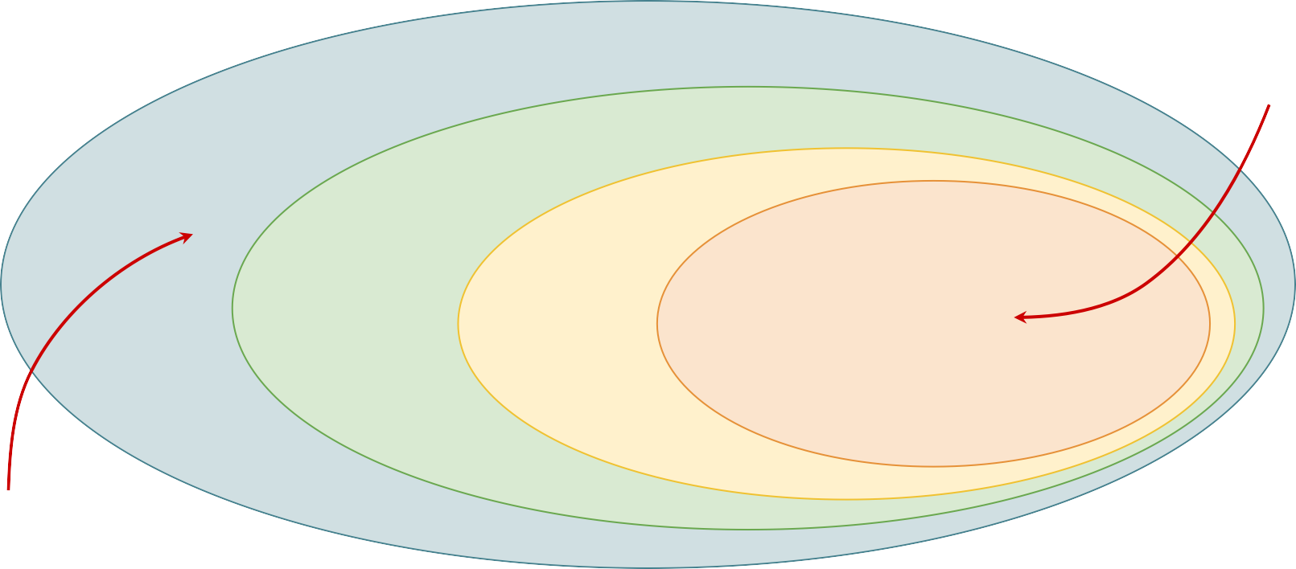
Hierarchy in levels of measurement
Strongest assumptions
Most permissive
Nominal
=, ≠
Named only
Ordinal
<, >
Interval
+, −
Ratio
✕, ÷
Has meaningful order
Has meaningful distances
Has an absolute zero
Weakest assumptions
12
Least permissive

Slide 13
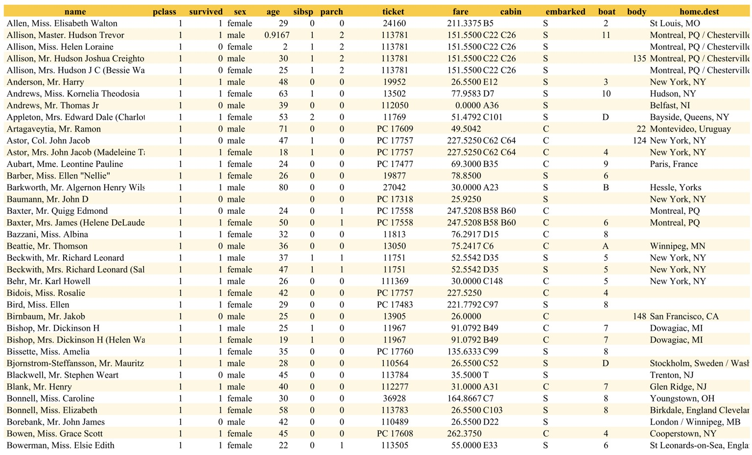
13

Slide 14
Ordinal
14

Slide 15
15

Slide 16
Nominal
16

Slide 17
17

Slide 18
Nominal
18

Slide 19
19

Slide 20
Ratio
20

Slide 21
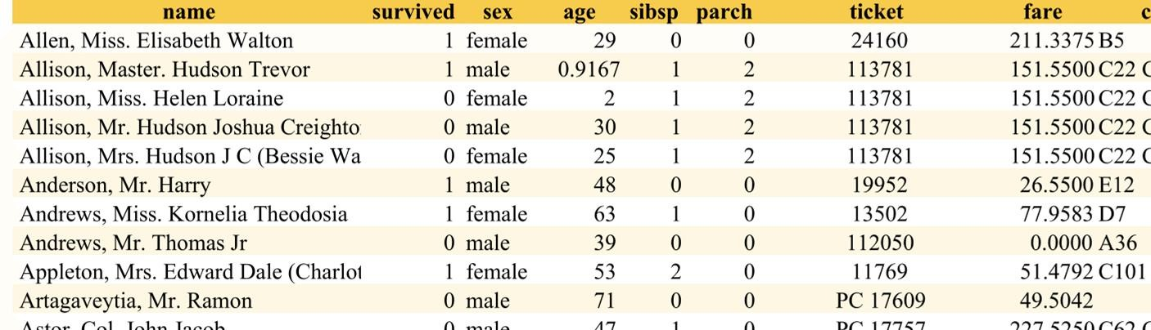
Numbers of variables
Velocity
35 | 50 | 60 | 40 | 20
Univariate data
You only have one attribute. E.g. time series
Bivariate data
You have two attributes. E.g. a table of longitude and latitude pairs
Multivariate data
You have N > 1 attributes
lon | lat
-6.258854 | 53.385381
-6.274475 | 53.360158
-71.094664 | 42.359980

Slide 22
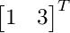
Data as vectors
Bivariate data points with quantitative variables
can be described using vectors in 2D space.
𝑦
(𝑥₁, 𝑦₁)
Multivariate data points can be described using vectors in 𝐷-dimensional space
(𝑥₂, 𝑦₂)
𝑥
This abstraction is very useful, since it allows us
to use linear algebra theory to manipulate data
22

Slide 23
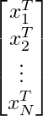
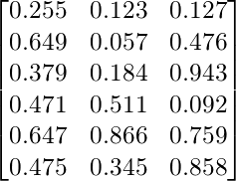
Datasets as matrices
Data points
We can stack quantitative data vectors into
matrices.
Usually we stack the items (data points, examples) in the rows, and the attributes (features) in the columns.
NB: some books/papers do the opposite!
For a dataset 𝑋 with 𝑁 items and 𝐷 attributes, we have a (𝑁 × 𝐷) matrix
N items
D attributes

Slide 24
One-hot encoding
Categorical attribute with 5 categories
Sometimes we want a vector encoding for a
nominal variable
Solution: one-hot encoding
Nominal attribute with 𝐾 possible values
becomes a 𝐾-dimensional vector
Transform a categorical variable with 𝐾
categories into 𝐾 binary variables
Very useful for encoding text
2
3
1
4
5
0 | 1 | 0 | 0 | 0
0 | 0 | 1 | 0 | 0
1 | 0 | 0 | 0 | 0
0 | 0 | 0 | 1 | 0
0 | 0 | 0 | 0 | 1
One hot-encoding: 5 binary
attributes (sparse matrix)

Slide 25
One-hot encoding of text
Can use one-hot encoding of words.
"The cat sat on the mat"
Set of all possible words is called the vocabulary.
The codebook assigns each word to an integer
The | 1
cat | 2
sat | 3
on | 4
the | 1
mat | 5
1 | 0 | 0 | 0 | 0
0 | 1 | 0 | 0 | 0
0 | 0 | 1 | 0 | 0
0 | 0 | 0 | 1 | 0
1 | 0 | 0 | 0 | 0
0 | 0 | 0 | 0 | 1
The | 1
cat | 2
sat | 3
on | 4
mat | 5
Codebook

Slide 26
Bag of words model of text
One way we represent an entire passage of
text is called the bag of words model.
Add up the rows of the one-hot encodings.
Note: throws away all information about
the ordering of words!
This representation is widely used in search engines and text analysis.
Note: may be useful to exclude uninteresting "stop words" like a, the, an, etc., from vocabulary
BoW encoding
The | 1
cat | 2
sat | 3
on | 4
the | 1
mat | 5
1 | 0 | 0 | 0 | 0
0 | 1 | 0 | 0 | 0
0 | 0 | 1 | 0 | 0
0 | 0 | 0 | 1 | 0
1 | 0 | 0 | 0 | 0
0 | 0 | 0 | 0 | 1
2 | 1 | 1 | 1 | 1

Slide 27
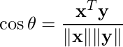
Why is this useful?
Summary statistics
Similarity
Most used words
Least used words
Average use of a word
Measure how similar documents are
Cluster similar documents
Topic modelling (PCA/LSI)
Visualization (t-SNE)
Unsupervised Learning
Information retrieval and search
Encode query using BoW
Encode all documents using BoW
Compare query with docs using similarity
metric (often cosine similarity)
x = doc₁
𝜃
y = doc₂
27

Slide 28



Multimedia data
Multimedia documents:
Text, hypertext
Images
Video
Audio
Types of analysis you might want to do:
Natural language analysis
Audio transcription, speaker identification
Face detection, recognition
Vehicle tracking
Automatic image tagging
...
Fields of study:
Computer vision (CV) is the field concerned with using computer models to understand visual content
Natural language processing (NLP) is
concerned with parsing, disambiguating, and understanding language
Automatic speech recognition (ASR) is concerned with using computer models to transform speech to text.

Slide 29
Representing multimedia data
Many different representations used in practice.
Images:
3D tensors:
As functions:
As vectors:
Compressed (JPEG, PNG)
Using automatically extracted features
Video: similar to images but with time. E.g.
Digital audio:
Sampled (44.1 KHz) quantized sound wave
Single or multi channel
Single channel sample of length N can be
represented as a vector in R^{N}
Function representation
Compressed (MP3)
Note: typically we do not store this kind of
multimedia data in tables. Why?

Slide 30
Summary
Data
metadata, semantics
measurements, attributes, values
Stevens’ four scales of measurement
Nominal
Ordinal
Interval
Ratio
Define what operations make sense
Number of variables/attributes
Univariate
Bivariate
Multivariate
Interpreting data as vectors
Datasets as matrices One-hot encoding
Multimedia

Slide 31
Data storage and I/O

Slide 32
Data storage and I/O
Data can come from files, databases, to be read from
streams
Data can be structured, unstructured, or semi-structured
Structured data: includes information on semantics such as relationships and data types. E.g:
Files:
Can be structured or unstructured
Good for distribution
Can be high performance
Tables
Graphs
Hierarchies
Relational databases
Databases:
Good for centralized information and network access
Can enforce structure via schemas
Multiple readers and writers
Query languages to filter and search
Semi-structured and unstructured data: semantic information missing or not machine readable. E.g:
Natural language plain text
HTML files
Word docs
Streams:
Real-time processing of live data (e.g. twitter)

Slide 33
File formats
Binary formats
Numeric values stored encoded in binary representation
32 bit float (4 bytes)
16 bit integer (2 bytes)
Properties:
Compact
High performance I/O
Not human readable
Need to worry about integer sizes, endiness, signed/unsigned
Plain text formats (ASCII and Unicode)
Numeric values encoded as ASCII or Unicode strings
float -> "3.1415926"
int -> "44"
Properties:
Human readable
(Somewhat) self-documenting
Slower I/O
Less compact

Slide 34
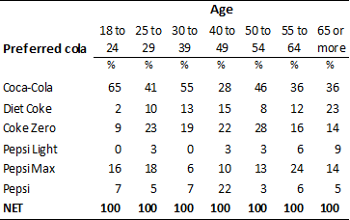


ASCII formats for tabular data
Tables are a common structure
with special formats available.
Two very common formats:
CSV: comma separated values
FWF: fixed width format

Slide 35
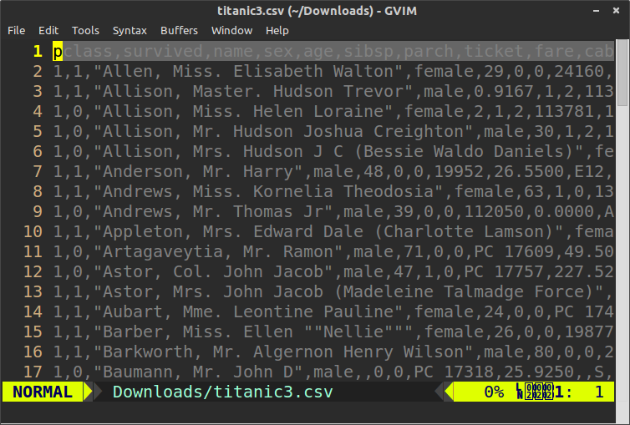
CSV
Comma separated values
Plain text format
Rows on lines
Columns separated by commas
Actually not only commas. Tabs, etc. (TSV)
Strings containing commas are
quoted

Slide 36
CSV
Advantages:
Can be read by Excel, OpenOffice, Google Sheets, etc.
Fast to parse/generate
Can be compressed (.csv.gz)
Do not need to load all into memory
(streamable)
Disadvantages:
Not standardised: many variations
Bulkier than binary formats esp. when uncompressed
No types
I/O in Python:
Python has a built in library for parsing CSV
import csv
with open('titanic3.csv') as f: reader = csv.reader(f)
for row in reader:
print(row[0], row[3])
with open('output.csv', 'w') as f: writer = csv.writer(f)
writer.writerow(['A', 1, 'female', 'red'])
Pandas can also read/write CSV
import pandas as pd
df = pd.read_csv('titanic3.csv') df.to_csv('output.csv')

Slide 37
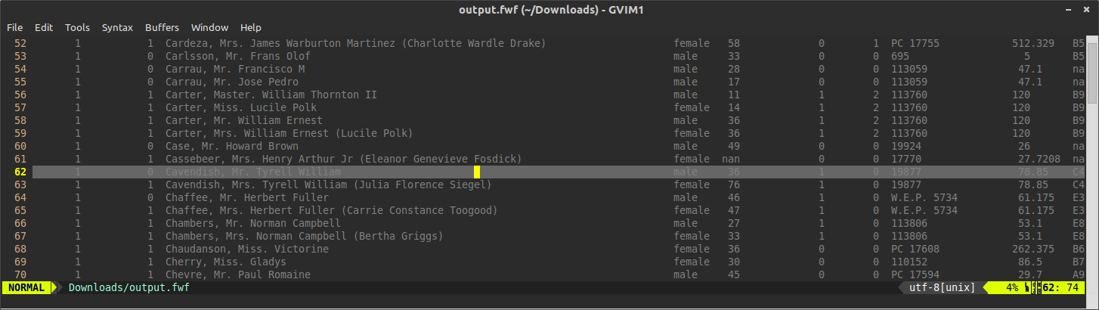
FWF
Fixed width format
Plain text format
Rows on lines
Columns of fixed width (fixed number of characters)
Columns padded using padding character (usually spaces)

Slide 38
FWF
Advantages:
Easier to read in plain text than CSV
Can be read by major spreadsheet programs
Fast to parse
Can be compressed (.fwf.gz)
Do not need to load all into memory
(streamable)
Disadvantages:
Not standardised
Bulkier than CSV (padding characters)
Need to establish field width before you
can write first row
No types
I/O in Python:
Pandas can also read FWF
import pandas as pd
df = pd.read_fwf('titanic3.fwf')
To write, you need the tabulate package
from tabulate import tabulate content = tabulate(
df.values.tolist(), list(df.columns), tablefmt="plain")
open('output.fwf', ‘w’).write(content)

Slide 39
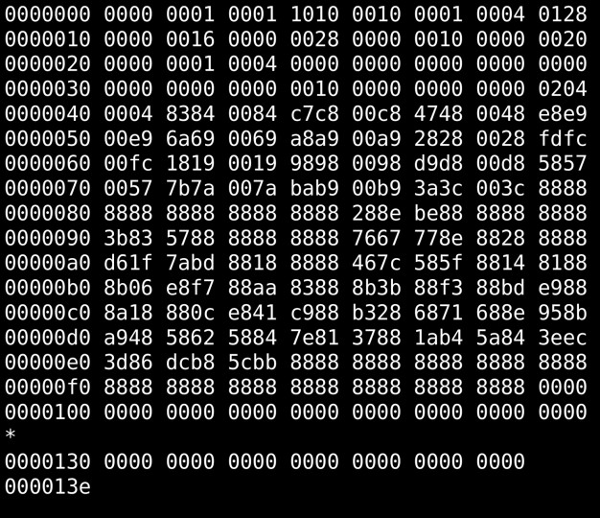
Binary formats for tabular data
Binary formats are more compact and performant.
Not human readable.
Common binary formats:
HDF5
MATLAB
NumPy
Apache Arrow and Feather
Excel

Slide 40

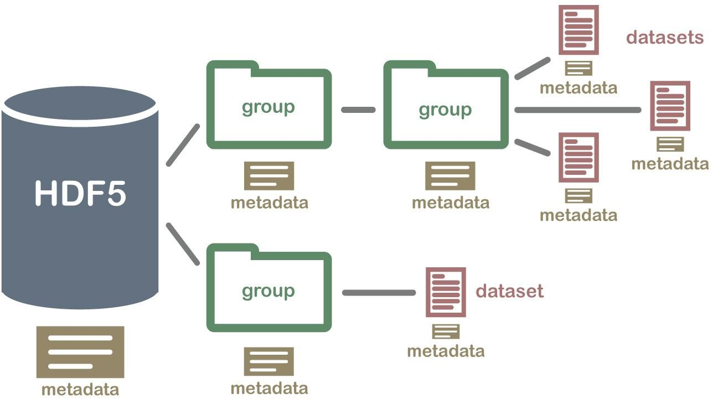
HDF5
Hierarchical data format version 5 (.h5)
Industry standard for storing numeric structured tabular data. Widely used in scientific community.
Can store multiple datasets in a single file.
Organize datasets into a hierarchical structure,
just like a filesystem
Include arbitrary metadata in the file using
metadata "attributes"
Uses memory mapping so entire dataset does not need to be loaded into memory. Memory can be shared between processes.
Library support in many languages.

Slide 41
HDF5
Advantages:
High performance
Compact
Multiple datasets in one file
Type information
Metadata
Parallel reads, shared memory
Optional compression
Disadvantages:
Not human readable
Can be cumbersome when table size is not known in advance
I/O in Python:
Can use h5py library
import h5py
f = h5py.File("mytestfile.hdf5", "w") dset = f.create_dataset(
"mydataset", shape=(100,), dtype='i')
Pandas can also read certain types of .h5 files (using PyTables)
pd.read_hdf('store_tl.h5', 'table') df.to_hdf('store_tl.h5', 'table', append=True)
store = pd.HDFStore('store.h5') store['mydataset']

Slide 42

MATLAB files
Proprietary format used by MATLAB software
(.mat)
Common for data exchange in industry and academia.
Can store multiple named arrays and various
other structures.
Newer versions of MATLAB (R2006b or later) now store data in HDF5-based files (.mat v7.3)
I/O in Python:
Scipy library includes functions for loading and
saving .mat files in the scipy.io package
scipy.io.loadmat
scipy.io.savemat
scipy.io.whosmat

Slide 43

NumPy
NumPy has built in support for two lightweight
binary formats for storing NumPy arrays:
.npy files contain single numpy arrays
.npz files contain multiple arrays
.npz files are actually zipped archives of .npy files. Arrays in .npz files can be named. The format also supports compression.
Advantages and Disadvantages
Fast, compact
Supports memory mapping
Built in support in NumPy
No metadata
Not standardized, less portable than H5
I/O in Python:
load(file[, mmap_mode, allow_pickle, ...])
Load arrays or pickled objects from .npy,
.npz
or
pickled files.
save(file, arr[, allow_pickle, fix_imports])
Save an array to a binary file in NumPy format.
savez(file, *args, **kwds)
.npy
Save several arrays into a single file in
uncompressed format.
.npz
savez_compressed(file, *args, **kwds)
Save several arrays into a single file in
format.
compressed
.npz

Slide 44
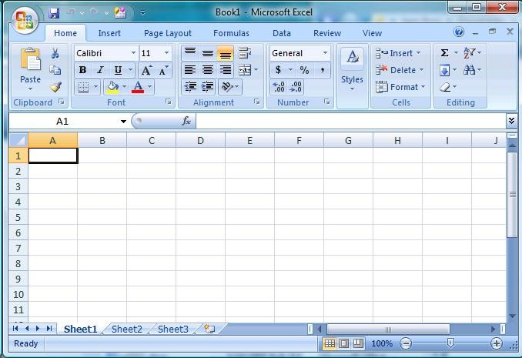
Excel format
Very common proprietary format used in
Microsoft Excel
XLS files, XLSX files
Advantages:
Works with MS products
Keeps “formatting” (colors, etc.)
I/O in Python:
Pandas has a function to read (read_excel) and method to write (DataFrame.to_excel)
Disadvantages:
Keeps “formatting”
Not portable
Proprietary
Also see http://www.python-excel.org/ for info on
other libraries for working with Excel
xlrd, xlwt

Slide 45


Common formats for structured data
More complex structures than plain tables (although can be reduced to
tables)
Structure: encode data types, attributes, relationships, hierarchies Common plain-text formats for structured data:
XML
JSON
YAML
Binary formats:
MessagePack
Google Protobuf

Slide 46

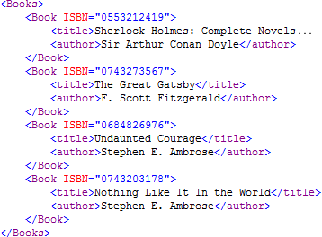
XML
Extensible Markup Language (XML)
Format for structured data designed to be both human and machine readable
Designed to be a self-describing format: no
additional documentation needed
XML document is a hierarchy made up of:
Elements: <book>
Attributes: ISBN="0553212419"
Content: Sherlock Holmes...

Slide 47
XML
Advantages:
Self-describing
"Human readable" (ish)
Disadvantages:
High overhead (extremely bulky)
Verbose
Slow parsers
Not well suited to big data and large scientific datasets
XML namespaces are a nightmare
Separate validation and DTD
Painful to type manually
No built-in types for scientific data
I/O in Python:
ElementTree in standard library. Stores entire XML structure in memory
import xml.etree.ElementTree as ET tree = ET.parse('input.xml')
root = tree.getroot() for child in root:
print(child.tag, child.attrib)
Several other ways in Python
SAX and Expat: event-driven parsing (callbacks)
See: https://docs.python.org/2/library/xml.html

Slide 48
JSON
JavaScript Object Notation
Subset of JavaScript for describing data Value types:
String
Number
Boolean
Object
Array
Null
Type is implicit in syntax
35 is a number
"35" is a string
{ "a" : 1 } is an object
[1, 2, 3] is an array
{
"employees":[
{"firstName":"John", "lastName":"Doe"},
{"firstName":"Anna", "lastName":"Smith"},
{"firstName":"Peter", "lastName":"Jones"}
]
}

Slide 49
JSON
Advantages:
Has types
Hierarchical
Human-readable
Self-describing
Easy to write by hand
More compact than XML
Faster to parse than XML
Most languages have parsers
Disadvantages:
Some overhead (plain text)
Not well suited to big data and large
scientific datasets
I/O in Python:
Super simple using built-in json module
import json
data = json.load(open('input.json'))
with open('output.json', 'w') as f: json.dump(data, f)
JSON now used in place of XML in many applications, especially web apps.

Slide 50
YAML
YAML Ain't Markup Language!
Like JSON, but easier to write by hand.
Very useful for configuration files and metadata files.
Slower than JSON
I/O in Python:
Using pyyaml
YAML: YAML Ain't Markup Language
What It Is: YAML is a human friendly data serialization
standard for all programming languages.
YAML Resources:
YAML 1.2 (3rd Edition): http://yaml.org/spec/1.2/spec.html YAML 1.1 (2nd Edition): http://yaml.org/spec/1.1/
YAML 1.0 (1st Edition): http://yaml.org/spec/1.0/ YAML Issues Page: https://github.com/yaml/yaml/issues YAML Mailing List: yaml-core@lists.sourceforge.net YAML IRC Channel: "#yaml on irc.freenode.net"
YAML Cookbook (Ruby): http://yaml4r.sourceforge.net/cookbook/ (local) YAML Reference Parser: http://ben-kiki.org/ypaste/
Projects:
C/C++ Libraries:
libyaml
Syck
yaml-cpp Python:
PyYAML
ruamel.yaml
import yaml
data = yaml.safe_load(open('input.yaml'))
# "C" Fast YAML 1.1
# (dated) "C" YAML 1.0
# C++ YAML 1.2 implementation
# YAML 1.1, pure python and libyaml binding
# YAML 1.2, update of PyYAML with ...

Slide 51

MessagePack
MessagePack: binary encoded JSON
Much more compact than JSON
Advantages:
Very compact
High I/O performance
Good for network I/O and databases
Good for bigger data
Streamable
Disadvantages:
Not human readable (but easy to decode)
Less suited to large numerical arrays
I/O in Python:
Msgpack library
>>> import msgpack
>>> msgpack.packb([1, 2, 3]) '\x93\x01\x02\x03'
>>> msgpack.unpackb(_) [1, 2, 3]

Slide 52

Google Protobuf
“Protocol buffers are Google's language-neutral, platform-neutral, extensible mechanism for serializing structured data – think XML, but smaller, faster, and simpler.”
Primarily designed for serializing data over the
wire, but can also be used as a file format
Protobuf defines a protocol specification language (prototxt) and a wire format.
Notably used for model specification and distribution by the well-known deep learning library developed by Berkeley: Caffe
Prototxt example:
message Person {
required string name = 1; required int32 id = 2; optional string email = 3;
}
I/O in Python:
Use Google’s protoc compiler to generate
“header” files. Then load and save with
ParseFromString(data) SerializeToString()

Slide 53
Things to consider when choosing a data format
❏ I/O performance
❏ Structure support (hierarchies, graphs, etc.)
❏ Streamable
❏ Scalability
❏ Appendable
❏ Portability
❏ Compactness
❏ Metadata
❏ Type support
❏ Readability
❏ Write by hand

Slide 54
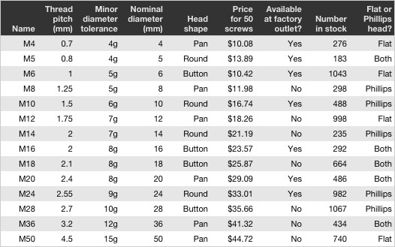

Databases
Databases are also common for data acquisition
and storage.
Advantages of databases include network access, concurrency, enforced consistency, fast indexes, query languages.
Not necessarily efficient for large binary data (e.g. images, video, audio, sensor data, astro).
Two important types:
Relational databases (SQL)
NoSQL databases

Slide 55
Summary of data formats and I/O
Files: Files are good for:
Plain text formats
Binary formats
Structured or unstructured
Semantics and metadata
Types
Data distribution
Ephemeral or intermediate results
High-speed processing
Multimedia data
Databases are good for:
Databases:
Centralized network data access
Concurrent access
Enforcing consistency
Subsetting and querying
(Caching)
SQL
NoSQL

Slide 56
Data wrangling

Slide 57
Real-world datasets
Real world datasets are often “dirty”: messy, complicated, inconsistent
Sources of problems:
Use (or lack of) incomplete standards
Manual entry errors (typos)
Measurement errors (equipment and noise)
Inconsistent notations (naming)
Redundancies and duplicates
Missing values (NAs)

Slide 58
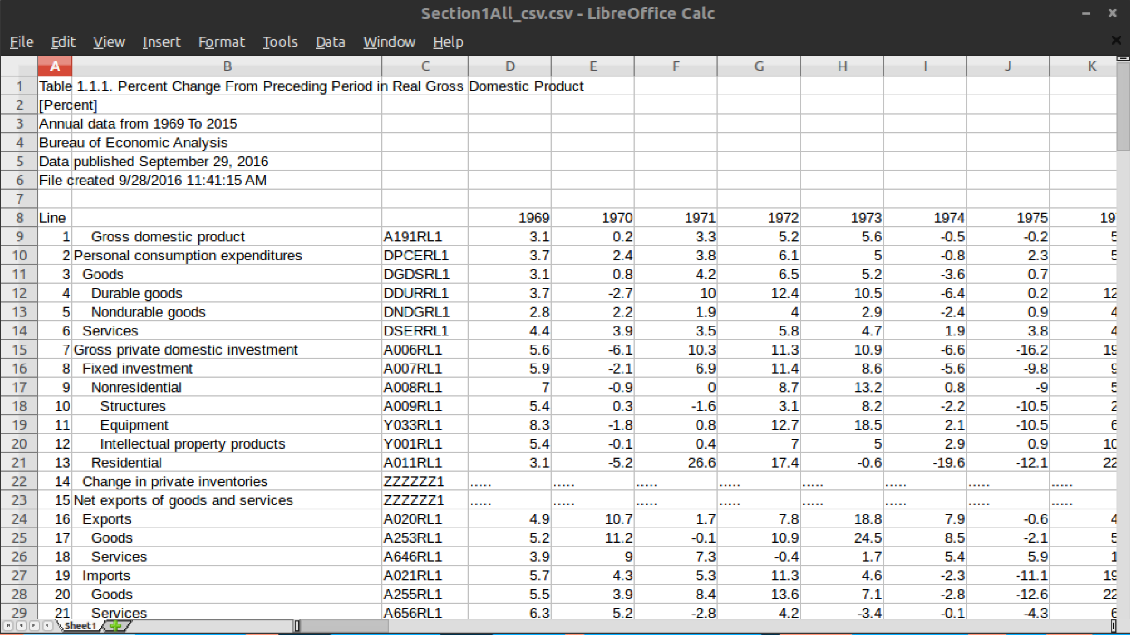

Slide 59
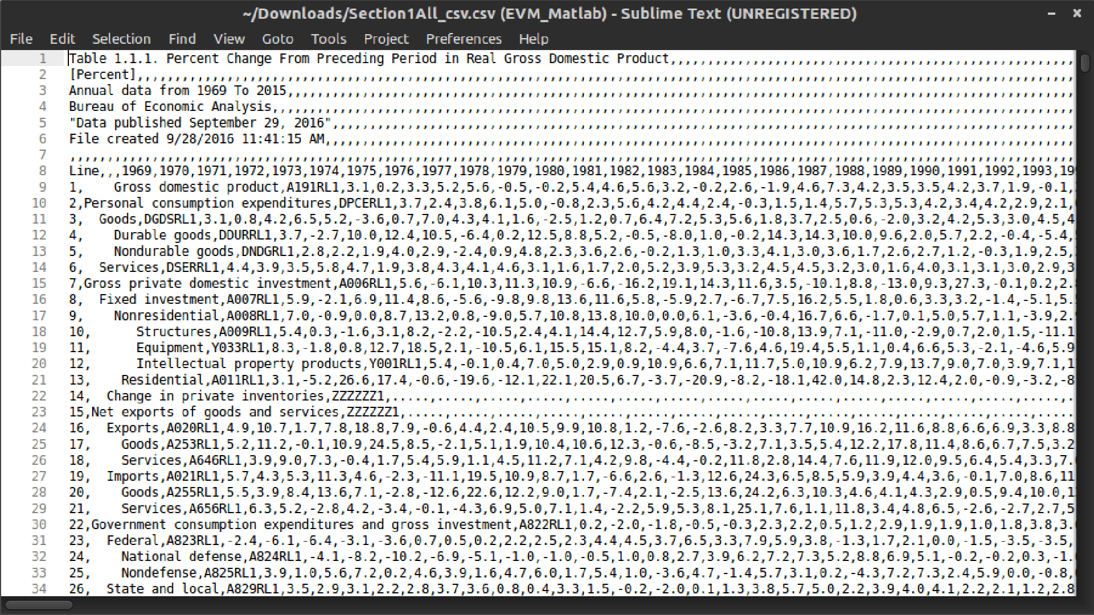

Slide 60
Headers need to be removed

Slide 61
Blank lines

Slide 62
Missing column names

Slide 63
Subheadings embedded in table

Slide 64
“Category” is actually a hierarchy of categories implied using whitespace

Slide 65
Data wrangling
Process of transforming “raw” data into data that can be analysed to
generate actionable insights
AKA:
Preprocessing
Munging
Cleaning
Scrubbing
Preparation
Transformation

Slide 66
Typical data wrangling tasks
❏ Fixing ugly and broken formats
❏ Handling missing values
❏ Removing redundant attributes and records
❏ Fixing inconsistencies
❏ Shaping data
❏ Fusing data sources
❏ Scraping and gathering data from external sources
❏ Extracting information from unstructured sources

Slide 67
Ugly and broken formats
Examples:
Badly formatted tables
Broken XML/JSON (syntax errors)
Hand entered data with syntax errors
Log files with strange formatting
:( :)
First step: transform to more machine friendly parsable format
Toolbox: Python csv module, text editor like vim, custom parsing scripts, regular expressions (re module), tabular, pandas

Slide 68
68

Slide 69
Missing values
Missing values are common and can have
significant effects on analysis and conclusions
Causes:
Non-response
Unobserved or unknown values
Sensor or measurement errors
Censorship
Errors in data collection or data entry
Often show up in datasets as:
Special NA values
GENDER | AGE | RELIG. | Q1
M | 18 | CR | ...
M | -1 | ATH | null
F | 22 | CR | ...
F | 36 | N/A | ...
NaN
null or None
Sentinel values (e.g age == -1)
Blanks
Important to try understand the reasons for missing values in order to appropriately deal with them…

Slide 70
Missing values
GENDER | AGE | RELIG. | Q1
M | 18 | CR | ...
M | -1 | ATH | null
F | 22 | CR | ...
F | 36 | N/A | ...
Three types of missing values:
Missing completely at random (MCAR): missing values are randomly distributed for all observations
Missing at random (MAR): probability of
value being missing depends on other
observed variables
Missing not at random (MNAR): probability of value being missing depends on value of missing variable or another unobserved variable.
MCAR and MAR assumption is common.
If assumptions are made when dealing with missing values, make them explicit!

Slide 71
Strategies for handling missing values
Three common approaches:
Ignore
Remove
Impute
Impute
Try to “fill in the blanks”
Note: good idea to include indicator variable to state if value was imputed
Common imputation techniques:
Mean/mode substitution
May introduce bias for MNAR values!
Predict from other attributes
Interpolation (e.g. time series)
Ignore
Drop missing values when computing summary statistics (e.g. mean, variance).
Remove
If plenty of data is available, may be possible to
simply ignore rows that have missing values
time
71

Slide 72
Redundant attributes
For example:
Useless attributes
Duplicated attributes
Attributes easily derived from other attributes
Can cause problems for some statistical analysis (e.g. regression models).
Eliminate redundancy where possible.
HUMAN | SEX | GENDER | HEIGHT (ft) | HEIGHT (cm)
Y | M | male | 5'9 | 175
Y | M | male | 6'4 | 193
Y | F | female | 5'10 | 178
Y | F | female | 6'1 | 185

Slide 73
Inconsistent categories (nominal attributes)
Ask 10 different people to do the same task and
they will do it 11 different ways!
For example:
Misspellings
Inconsistent spellings
Hyphenation
Inconsistent case
Inconsistent abbreviations
GENDER | STATE
Male | NY
male | New York
F | "New-york"
fem. | Califrnia, USA
Techniques:
Print unique vals and try to detect outliers and
splits
Normalize case and spelling
Tools:
Unix sort | uniq
Python sort, set()
str.lower, str.replace,
Regular expressions (re)

Slide 74
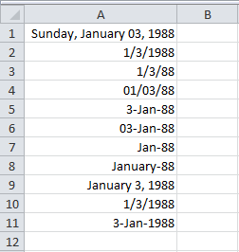
Dates and times
Huge variation in ways dates, times, and
timestamps can be represented.
Data cleaning should standardize to a single format.
Preferably include timezone information.
Standard plain text format: ISO8601
2016-10-10T16:04:07+00:00

Slide 75
Parsing dates and times
Input | Parse
19 November 1975 | Wed Nov 19 08:41:38 1975
19 November 75 | Wed Nov 19 08:41:38 1975
19 Nov 75 | Wed Nov 19 08:41:38 1975
tomorrow | Tue Jun 21 09:00:00 2016
yesterday | Sun Jun 19 09:00:00 2016
10 minutes from now | Mon Jun 20 08:51:38 2016
the first of January, 2001 | Mon Jan 1 08:41:38 2001
3 days ago | Fri Jun 17 08:41:38 2016
Python standard library:
datetime.strptime(str, fmt)
The parsedatetime library:
Will parse almost anything!
import parsedatetime
cal = parsedatetime.Calendar() cal.parse("tomorrow")
Also consider using arrow library if you do a lot
of date and time manipulation

Slide 76
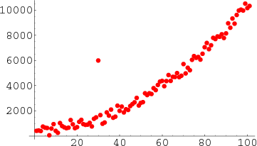
Outliers
Data points that are extremely unlikely under the
data distribution (far from other data points).
Causes:
Measurement error
Recording error
Statistical anomalies (may be interesting!)
Often you'll want to identify outliers prior to further analysis.
Measure quantity of outliers
Label outliers
Completely remove outliers

Slide 77
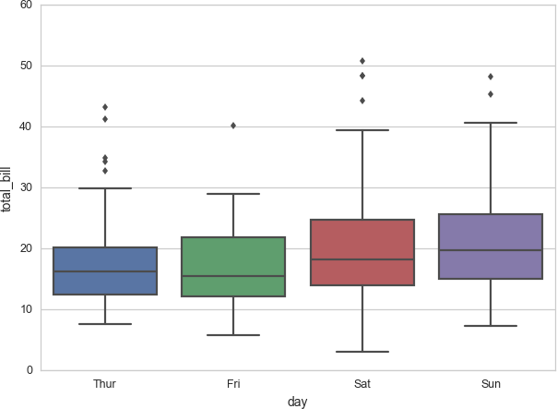
Detecting outliers
Often you can detect outliers by plotting your
data and doing some visual inspection.
Boxplots, jitter plots, histograms
More details next lecture!
Alternatively, you can make some assumptions about the distribution of the attribute and find items that are unlikely under this distribution.

Slide 78
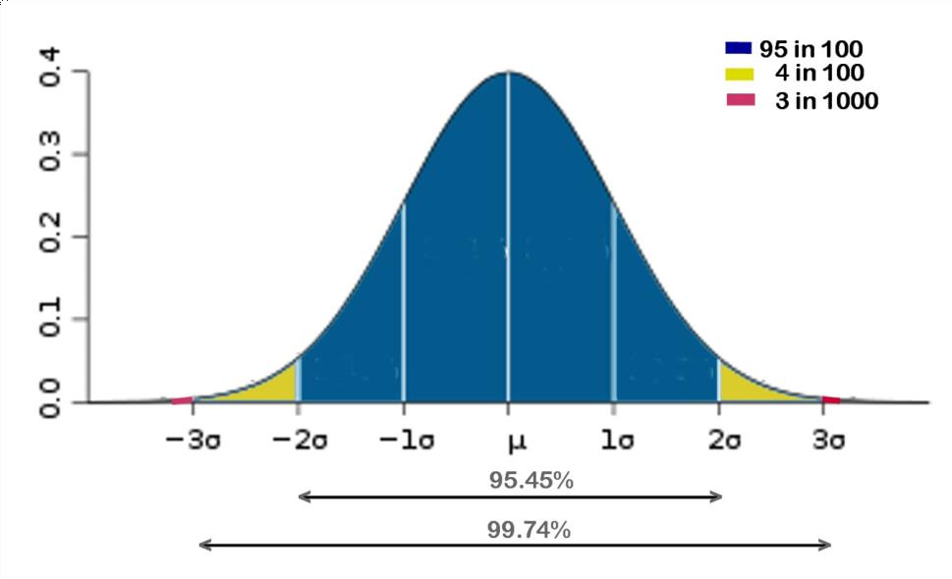
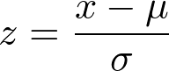
Detecting outliers
E.g. assume data is normally (Gaussian)
distributed.
Estimate sample mean and standard deviation from data and compute Z scores.
sample mean
sample standard deviation
z=3
78

Slide 79
Data shaping
Data often stored in "stacked" or record format
Sometimes more convenient to have one
"observation" per row with multiple attributes
date | variable | value
2000-01-03 | A | 0.469112
2000-01-04 | A | -0.282863
2000-01-05 | A | -1.509059
2000-01-03 | B | -1.135632
2000-01-04 | B | 1.212112
2000-01-05 | B | -0.173215
2000-01-03 | C | 0.119209
2000-01-04 | C | -1.044236
2000-01-05 | C | -0.861849
2000-01-03 | D | -2.104569
2000-01-04 | D | -0.494929
2000-01-05 | D | 1.071804
date | A | B | C | D
2000-01-03 | 0.469112 | -1.135632 | 0.119209 | -2.104569
2000-01-04 | -0.282863 | 1.212112 | -1.044236 | -0.494929
2000-01-05 | -1.509059 | -0.173215 | -0.861849 | 1.071804
This can be achieved by reshaping or pivot operations. In pandas:
df.pivot(index='date', columns='variable',
values='value')

Slide 80
Fusion of data sources
ID | GENDER | LOC | AGE
1 | F | COR | 32
2 | F | DUB | 25
3 | F | DUB | 19
4 | M | LIM | 43
ID | Q1 | Q2 | Q3
1 | N | Y | 1
2 | Y | Y | 3
3 | Y | N | 2
4 | N | Y | 1
JOIN ON ID
ID | GENDER | LOC | Q1 | Q2 | Q3
1 | F | COR | N | Y | 1
2 | F | DUB | Y | Y | 3
3 | F | DUB | Y | N | 2
4 | M | LIM | N | Y | 1

Slide 81
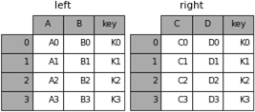
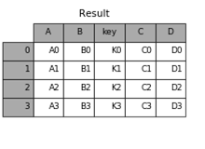
Fusion of data sources
Pandas
result = pd.merge(left, right, on='key')
Lots more options for merging and concatenation.
See docs.
SQL Inner Joins
SELECT
left.A, left.B, left.key,
right.C, right.D
FROM left
INNER JOIN right
ON left.key = right.key;

Slide 82
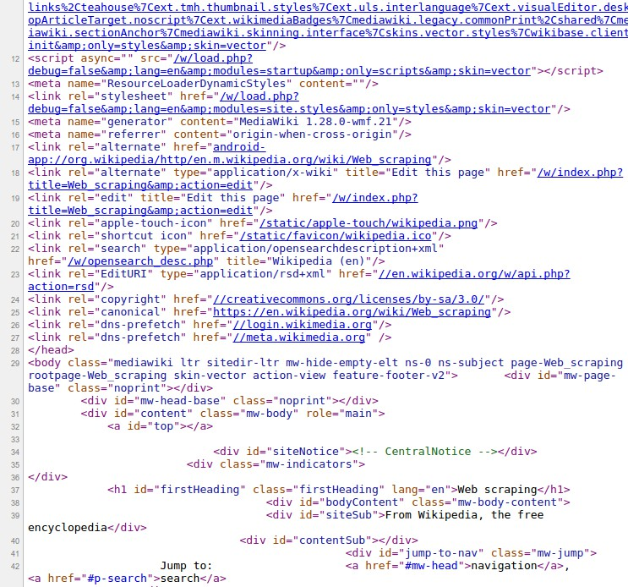
Dealing with unstructured data
So far we've talked mostly about cleaning structured data (even if structure is awful!)
What about semi-structured and unstructured
data?
Natural language plain text
HTML files
Usually we'll want to extract some features from this type of data for analysis
We've already seen one way of encoding text features:
bag-of-words
82

Slide 83
Web scraping: getting data from webpages
Idea: extract structured information from unstructured web pages by automatic
downloading and parsing them.
Task | Issues | Toolbox
Getting the data | HTTP requests, cookies, headers, downloads, JavaScript, timing | wget, curl requests, mechanize, selenium
Figuring out which data to get | Link crawling and spidering | scrapy
Extracting structured information | Robust parsing, DOM querying | PyQuery, BeautifulSoup, lxml

Slide 84
Web scraping
wget, curl
Convenient command line tools.
$ curl https://curl.haxx.se >> page.html
requests
Easily make HTTP requests directly in Python
>>> r = requests.get(
'https://api.github.com/user', auth=('user', 'pass'))
>>> r.status_code 200
>>> r.headers['content-type'] 'application/json; charset=utf8'
>>> r.text
u'{"type":"User"...'
>>> r.json()
{u'private_gists': 419, u'total_private_repos': 77, ...}
mechanize
Stateful programmatic web browsing. Pretend to be a browser (cookies and headers and all)
browser = mechanize.Browser() browser.open("http://www.example.com/")
response = br.follow_link(text_regex=r"cheese\s*shop", nr=1) print(browser.title())
print(response.geturl())
print(response.info()) # headers
print(response.read()) # body
selenium
Remote control an actual browser!
driver = webdriver.Firefox() driver.get("http://www.python.org") elem = driver.find_element_by_name("q") elem.clear()
elem.send_keys("pycon") elem.send_keys(Keys.RETURN)

Slide 85
PyQuery
Parsing and querying HTML with PyQuery:
<!DOCTYPE html>
<html>
<head>
<title>PyQuery Test!</title>
</head>
<body>
<h1>PyQuery is AWESOME!</h1>
<p><a
href="http://pypi.python.org/pypi/pyquery">PyQuery</a>
is a Python port of the famous
<a href="http://jquery.com">jQuery</a> JavaScript library.
<h2>What is it Good For?</h2>
<ul id="pitch">
<li>It makes parsing files a <strong>SNAP</strong>!</li>
<li>DOM Manipulation is EASY!</li>
<li>You <em>never</em>
have to worry about confusing syntax</li>
</ul>
</body>
</html>
>>> from pyquery import PyQuery
>>> html = open("index.html", 'r').read()
>>> pq = PyQuery(html)
>>> pq("title").text() 'PyQuery Test!'
>>> pq("li").eq(1).text() 'DOM Manipulation is EASY!'
>>> for x in pq("a"):
...
...
PyQuery
jQuery
print pq(x).text()
>>> pq("ul").children().eq(0).html()
u'It makes parsing files a <strong>SNAP</strong>!'

Slide 86
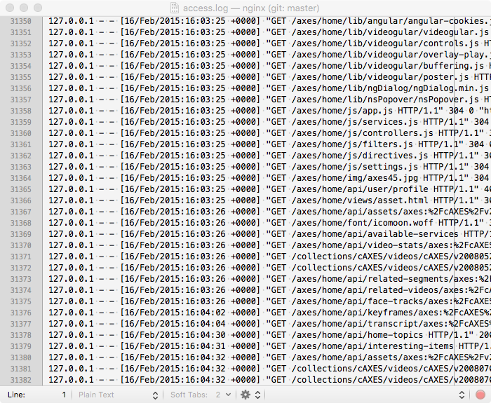
Processing log files
Log files are a good example of semi-structured data. Log analysis: making sense and extracting information from log files.
Regular expressions and string partitioning are useful tools:
Built-in Python re module
Python string functions:
str.split, str.rsplit
str.partition, str.rpartition
str.find, str.rfind, str.replace
str.strip, str.upper, str.lower
str[a:b:c]
Unix tools: sed, awk, grep, vim

Slide 87

Data wrangling best practices
❏ Keep raw data separate from cleaned data. Never overwrite raw data. You may need it again. Keep backups!
❏ Script data wrangling steps as much as possible. If you need to change something later on, it's far easier if the steps are scripted.
❏ Document all the transforms carried out and assumptions made. Distribute this documentation with the cleaned dataset. Try make the wrangling process as reproducible as possible.
❏ For large datasets, start with a small random sample. Iterate faster: once you have perfected your cleaning steps on the sample, apply to full dataset.
87

